Slide 1
Insights of Wildfires in the united states
A presentation by: Areej, Isaac, Justin &, Sandra.

Slide 2
Project Scope:
To visualize the trend for all the wild fires in the United States per years.
The causes of these wild fires in each states by the counts of each cause.
The fire sizes per state
Research Questions to Answer:
Are wildfires on the rise in the United States?
Effects of the climate changes in the spread of the wildfires all over the Unites States.
Wildfires damage and the impact on the economy .

Slide 3
Data Sets to be Used:
Data for this study is obtained from Kaggle.com. This database is a spectacular collection of data on wildfires in the United States from 1992 to 2015 created to support the US Fire Program Analysis. It has data on nearly 2 million wildfires over this time period
Link: https://www.kaggle.com/rtatman/188-million-us-wildfires

Slide 4
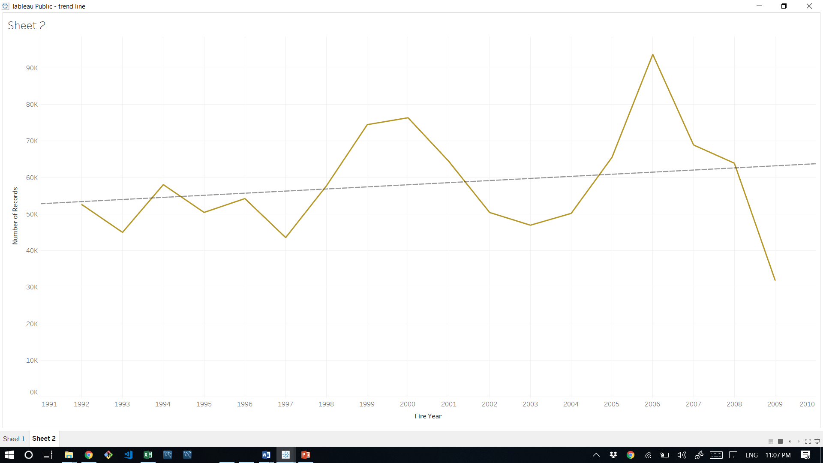
The trend:
The number of fires per year ran between 45,000 and 100,000. There was a spike in fires in 2006 to more than 100,000. There is a small upward trend during this time period.

Slide 5
Add justins graph

Slide 6
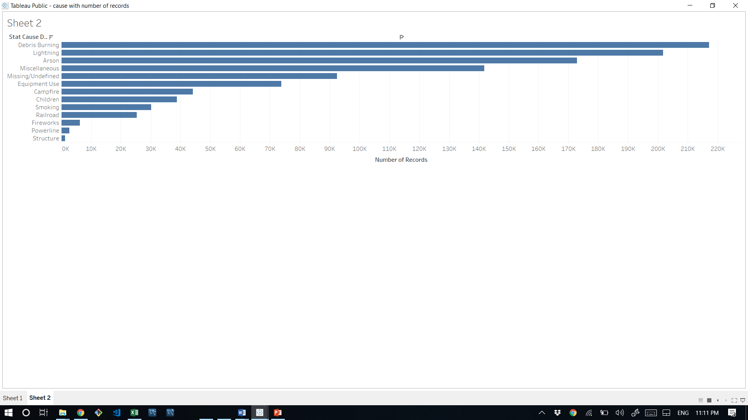
Cause:
Debris burning was the largest cause of wildfire by a significant margin.

Slide 7
Graph from justin

Slide 8
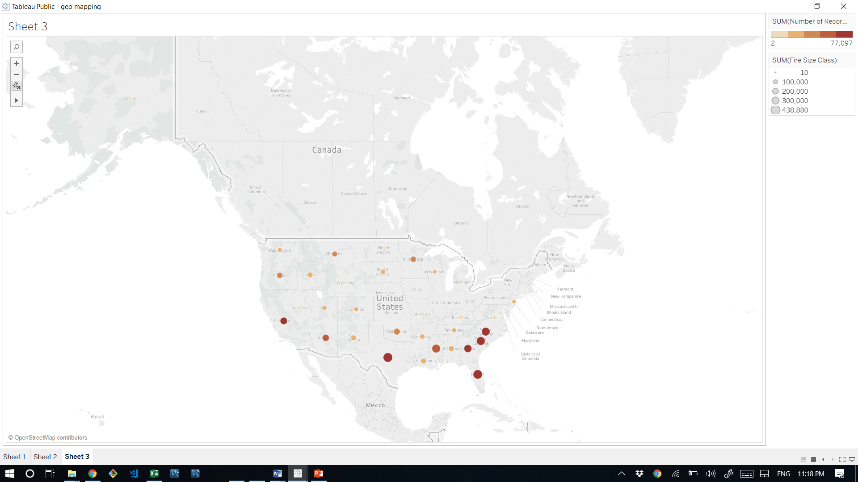
Fire size per state
?????????????????

Slide 9
Justin graph

